Slide 1


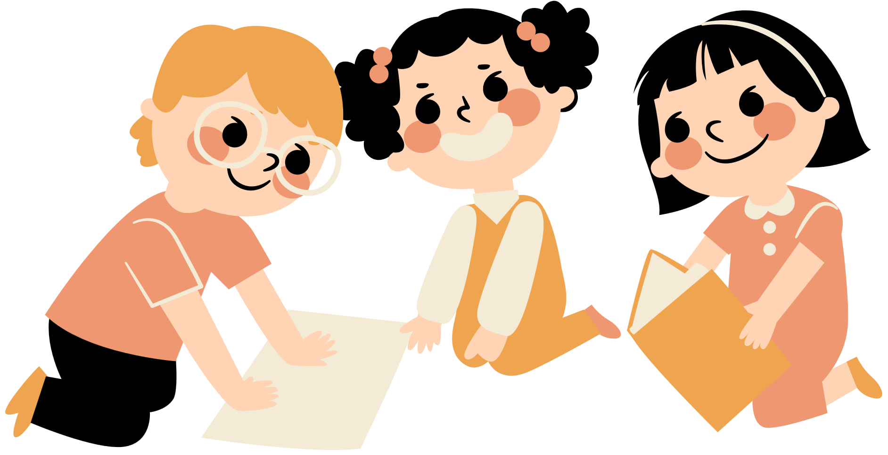
Unit 11
There’s a doll on the rug.
Lesson 2

Slide 2
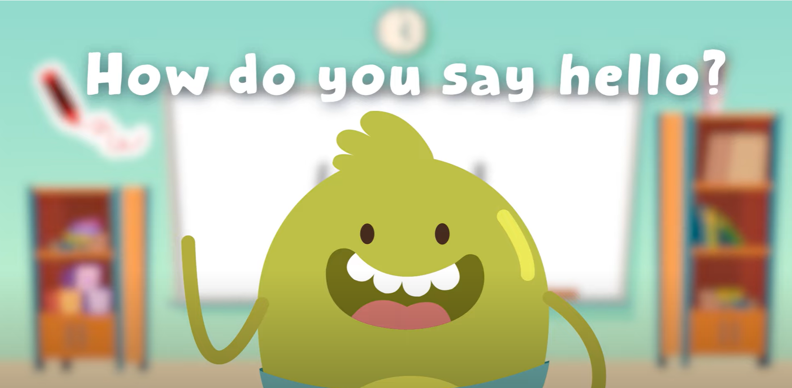
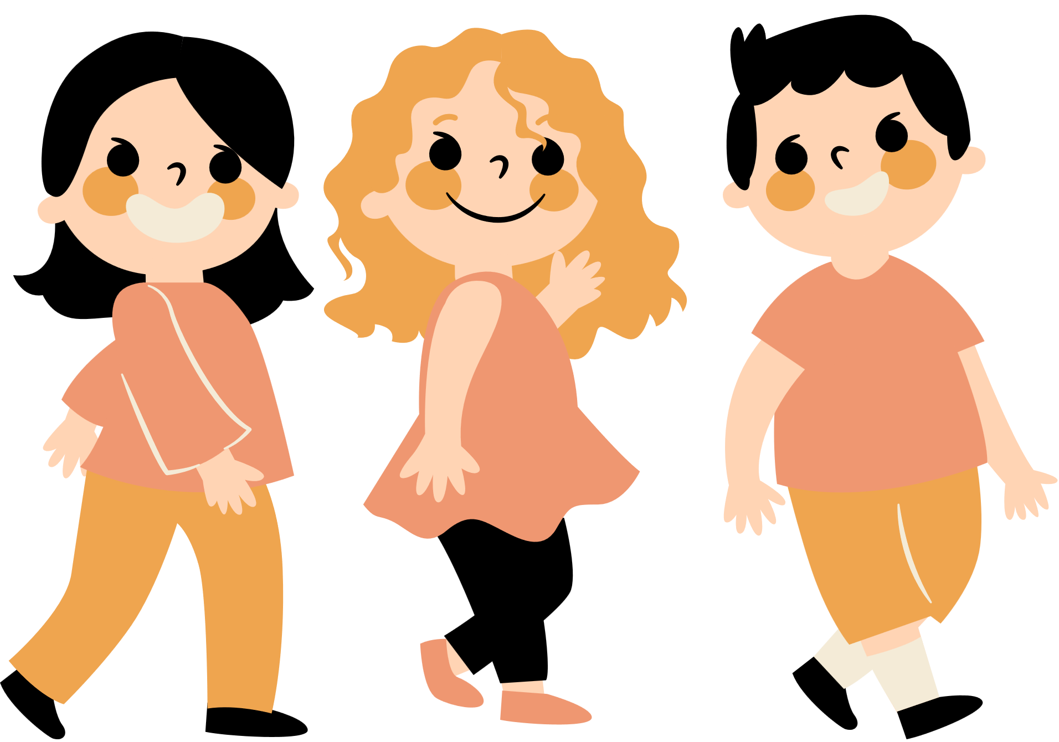
Hello song

Slide 3


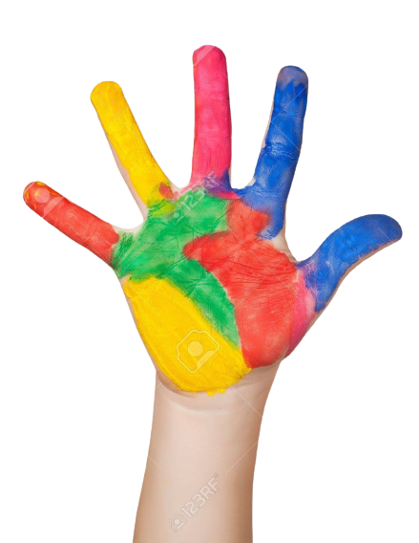



Give me Five

Slide 4
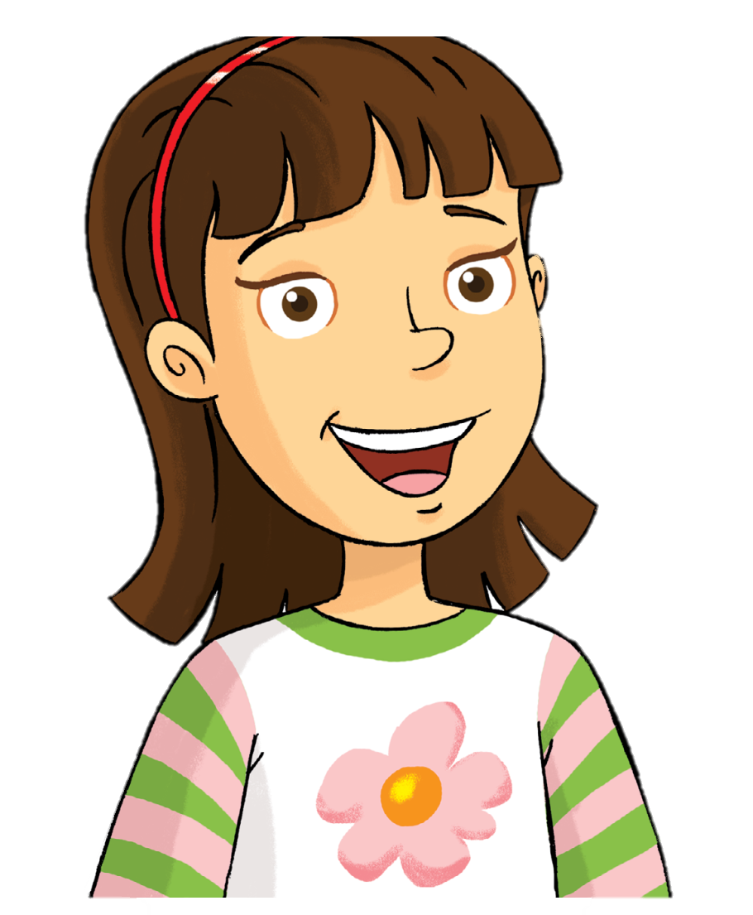
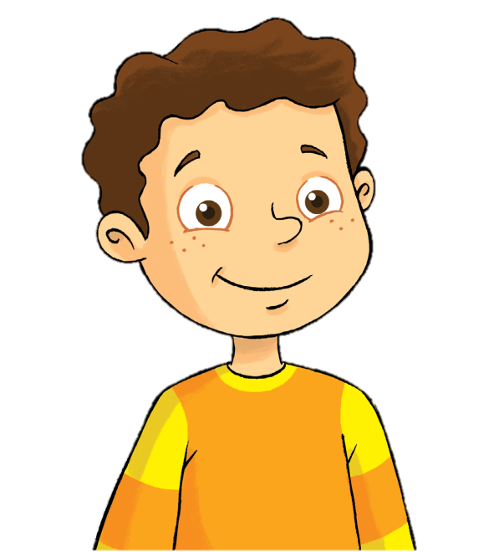
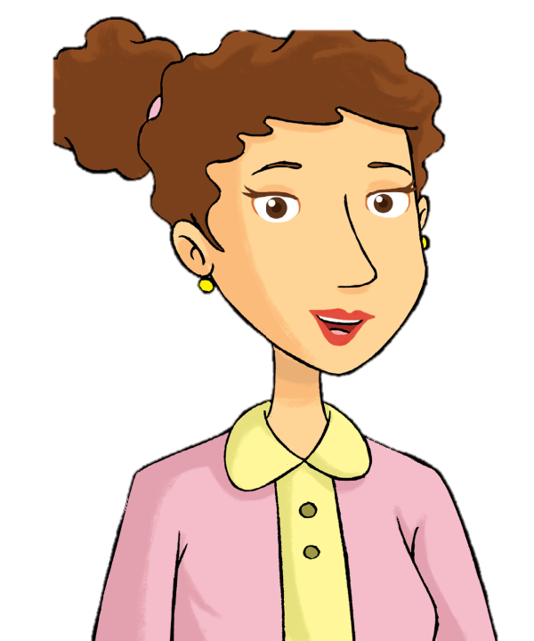

Remember
Rosy
Billy
mom
dad

Slide 5

Watch and Say

Slide 6
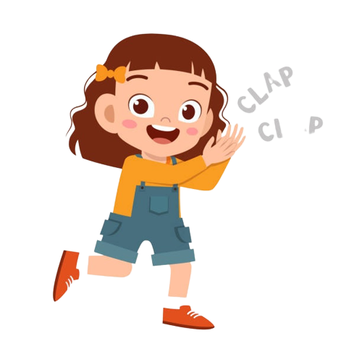
Good job!

Slide 7
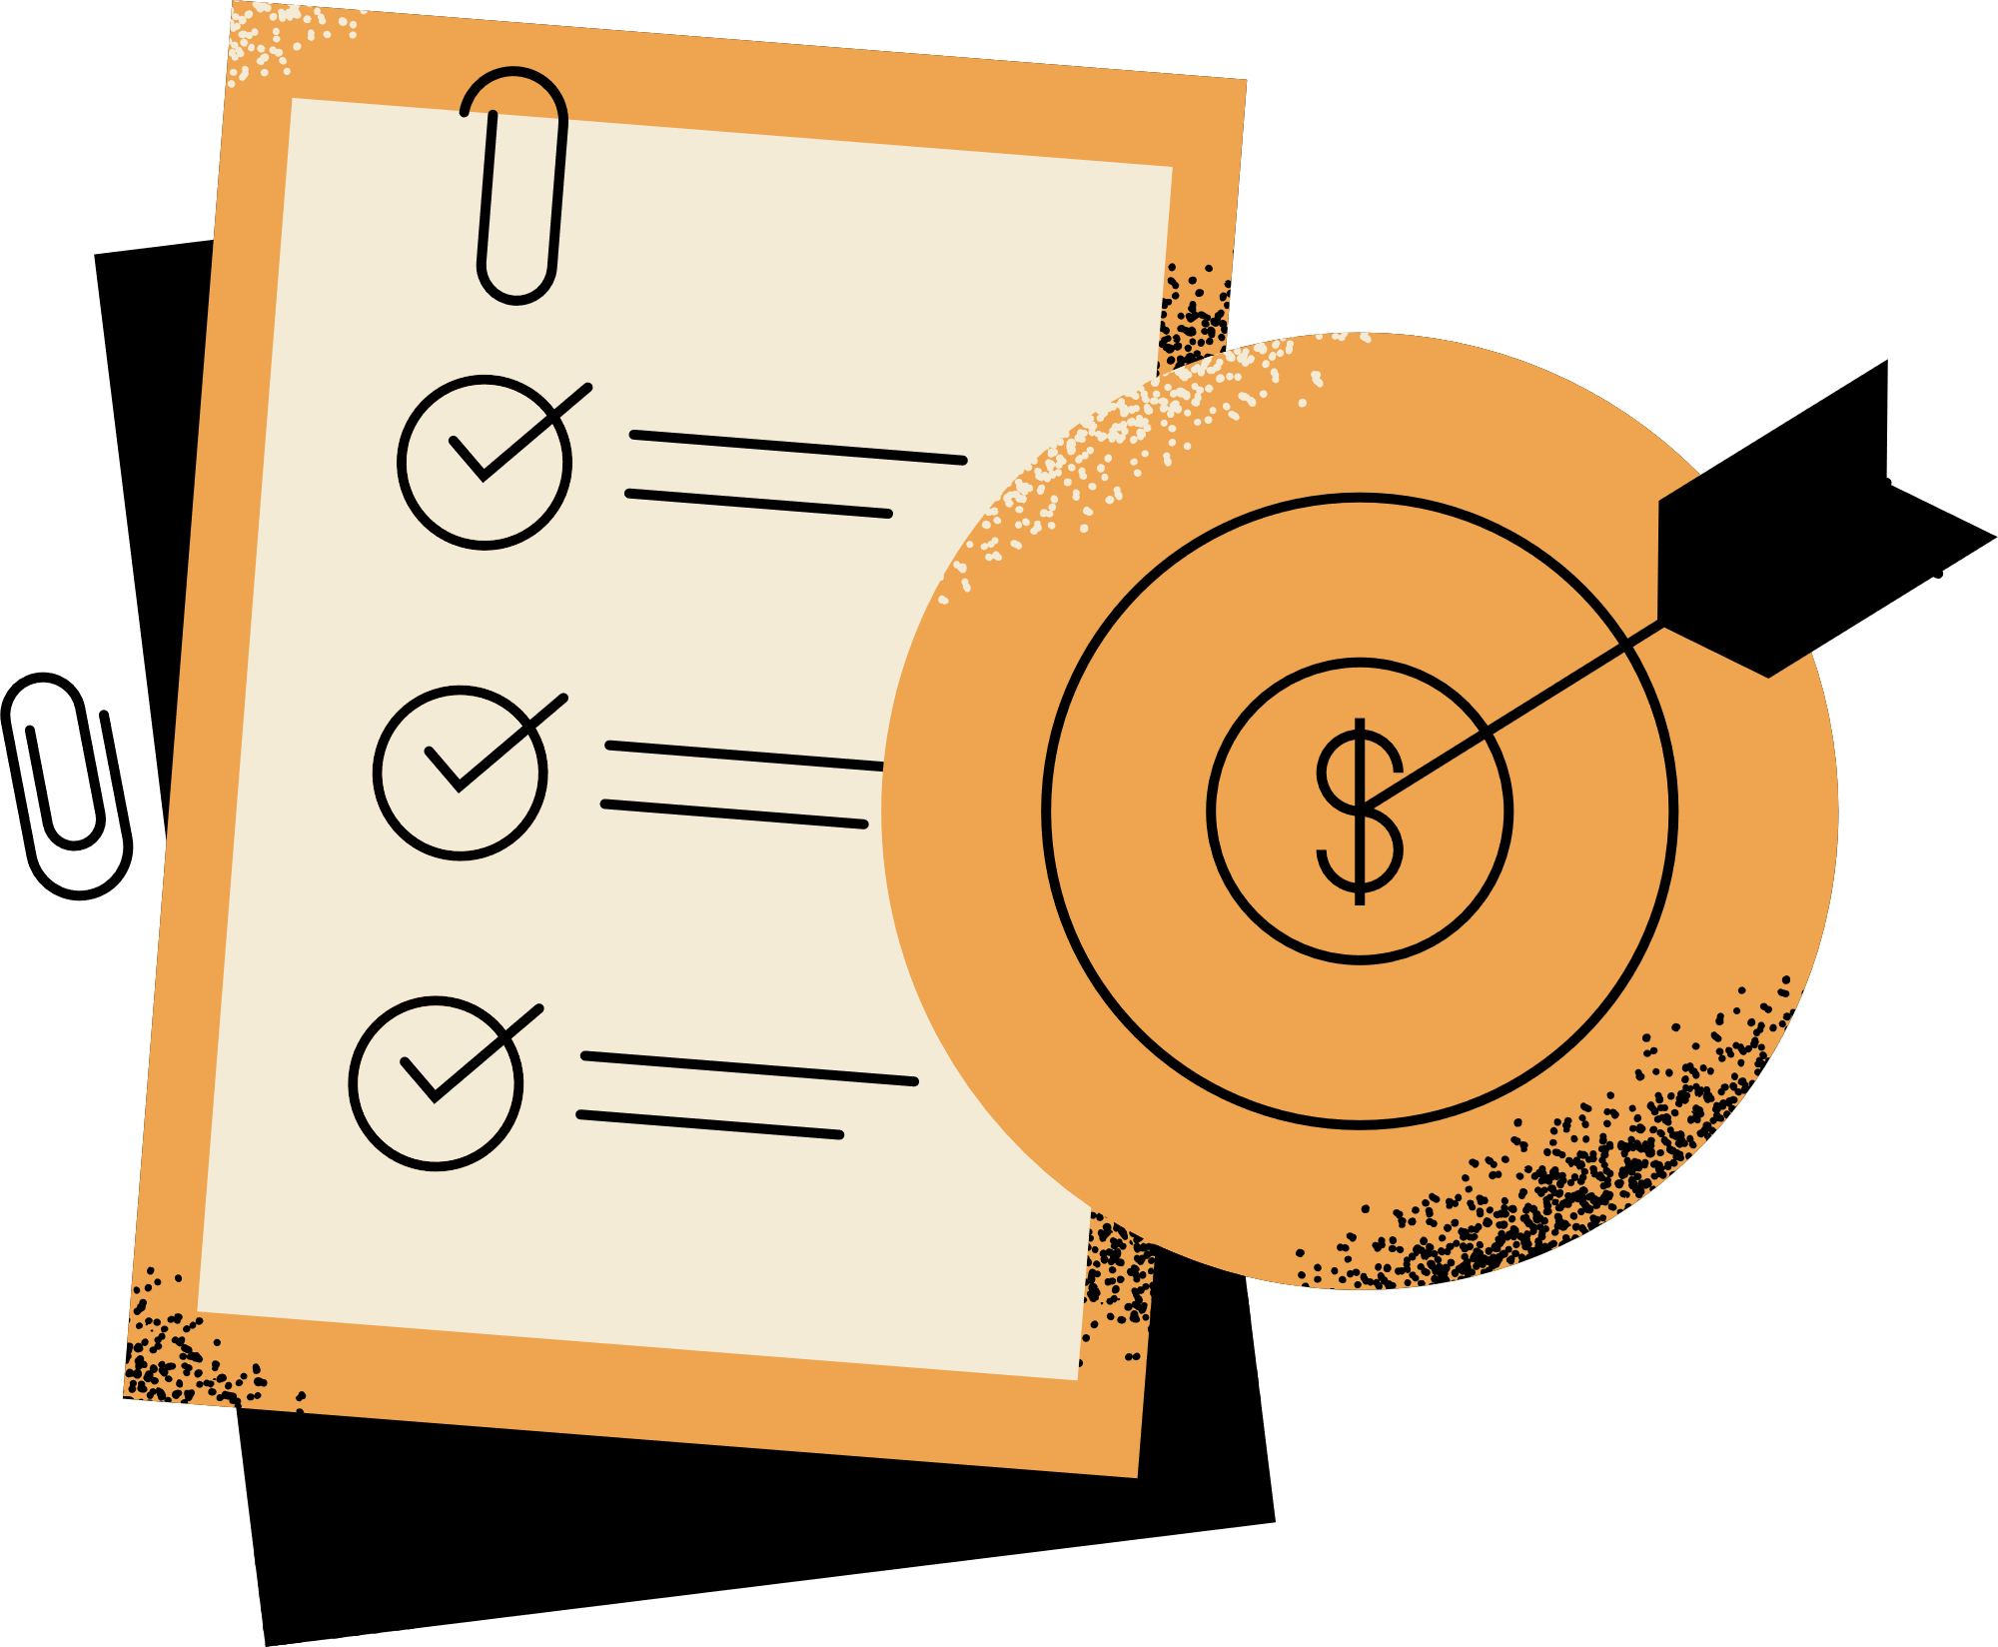

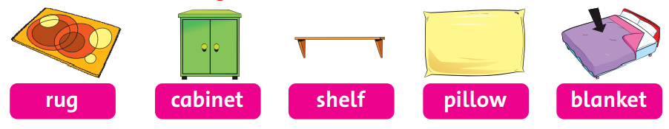

Listen
and
Chant

Slide 8
Good job!

Slide 9


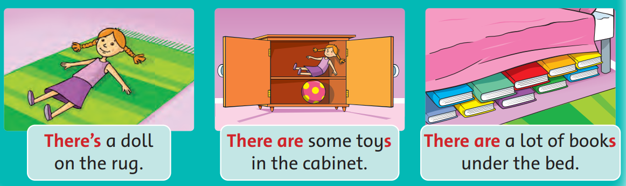
Listen and Point

Slide 10
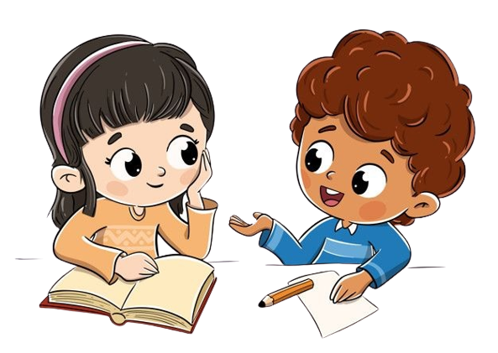

Work in groups
Role-Play

Slide 11
Good job!

Slide 12

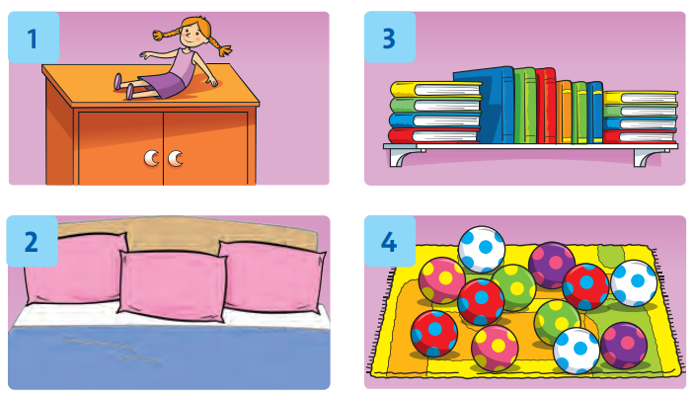
Look and Say

Slide 13
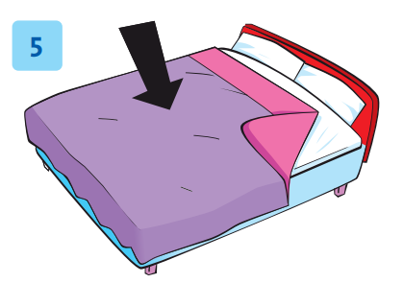
Look and Say

Slide 14
Work in groups
Role-Play

Slide 15
Good job!

Slide 16
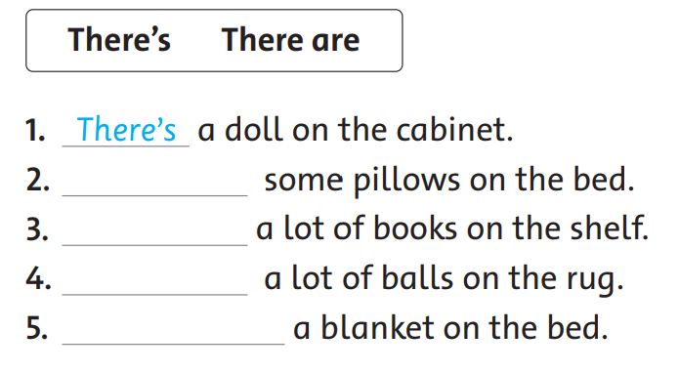
Look and Write
There are
There are
There are
There’s

Slide 17
Work in groups
Role-Play

Slide 18
Good job!

Slide 19

Game

Slide 20
Good job!

Slide 21
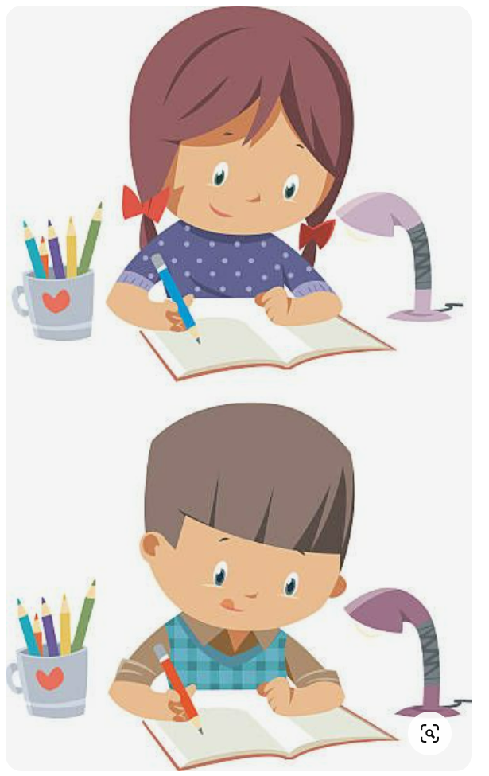
Homework

Slide 22

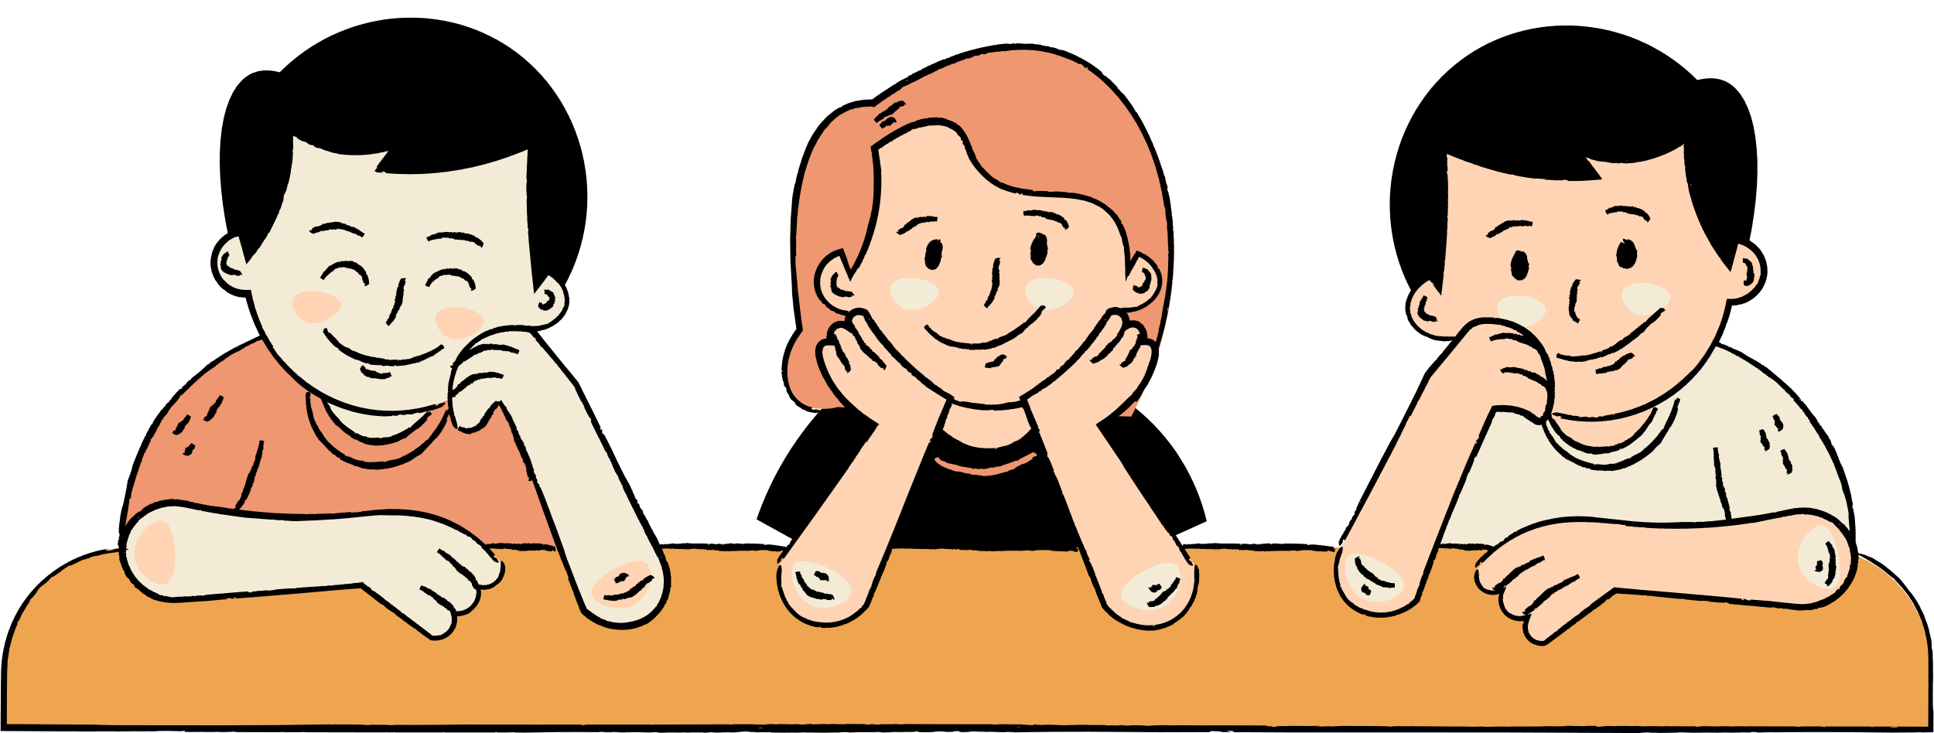
Thank You

